Slide 1
UNIT 3
FUNCTIONS
DATA STRUCTURE
OOP
By Swarnima Mitra

Slide 2
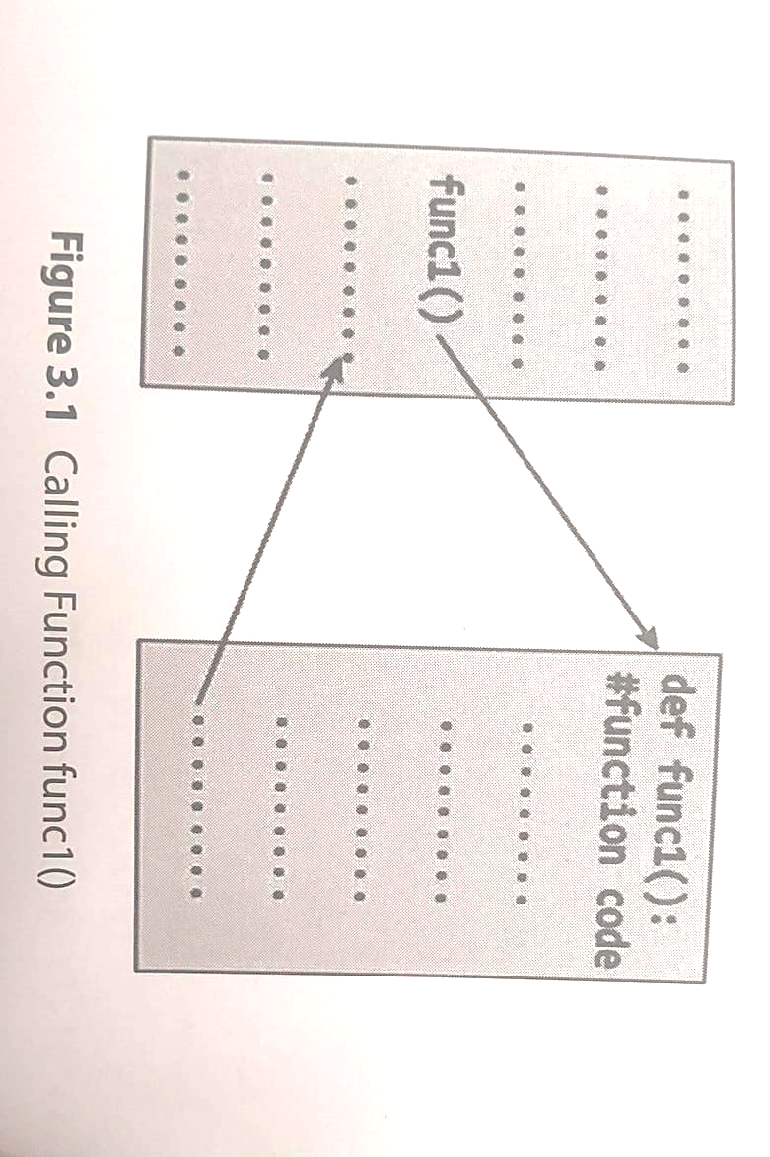
FUNCTION
A function is a block of organized and reusable program code that performs a single, specific and well-defined task.

Slide 3
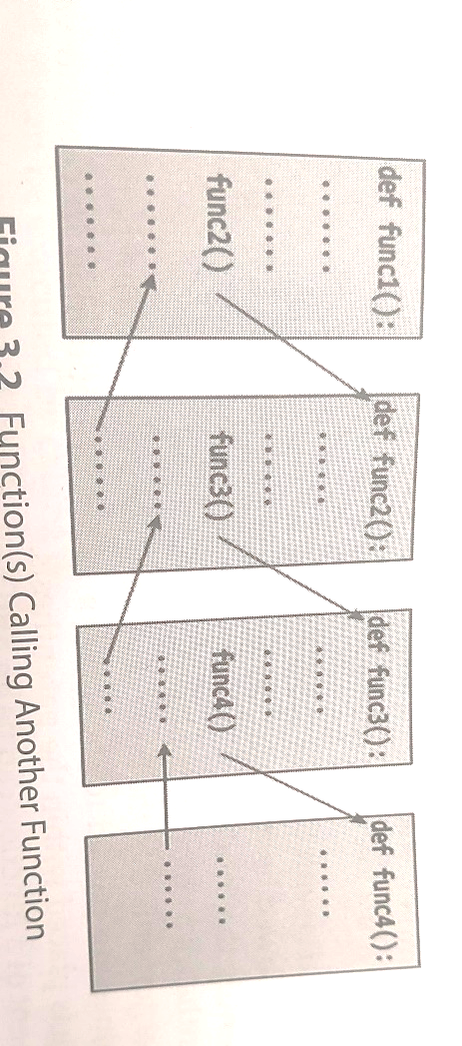
When the compiler encounters a function call, instead of executing the next statement in calling function, the control jumps to the statements that are a part of the called function.
Here func1() calls another function named func2().
func1() is known as calling function.
func2() is known as called function.

Slide 4
Pointers to remind:
A function, f that uses another function g, is known as calling function and g is known as the called function.
The inputs that the function takes are known as arguments/parameters.
When a called fn returns some result back to the calling fn, its called return that result.
If the called fn accepts arguments, the calling fn will pass parameters otherwise not.

Slide 5
Function Declaration & Definition
Function declaration : A declaration statement that identifies a function with its name, a list of arguments that it accepts and the type of data it returns.
Function definition : It consists of a function header that identifies the function, followed by the body of the function containing the executable code for that function.

Slide 6
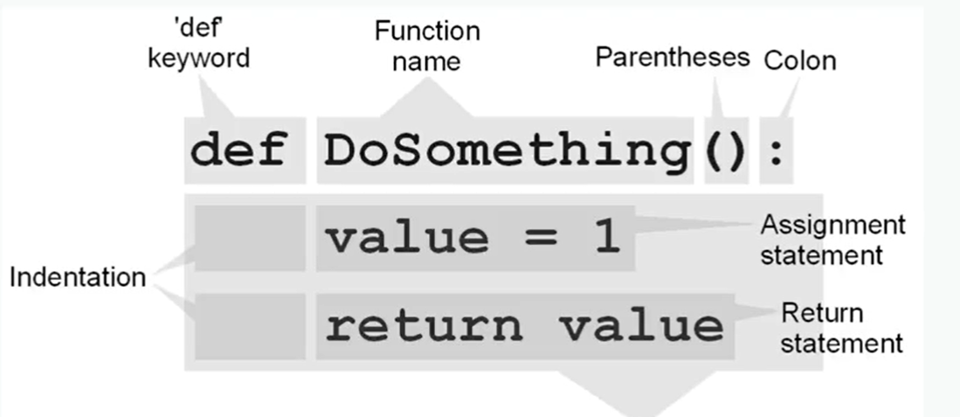
PYTHON FUCTION
FUNCTION BODY

Slide 7
Define a function – User defined
Function blocks starts with the keyword def.
Keyword followed by the function name and (). The fn name is used to uniquely identify the function.
After (), place colon(:)
Parameters are in parentheses. Values are passed through them and are optional. If not used, the parentheses are empty.
The code block within the function id properly indented to form the block code.
A function’s return statement is optional. If presents, it sends an [expression] back to the caller. A return statement with no argument is equivalent to return None.

Slide 8
Program that adds two numbers using function
OUTPUT:
30
def add(x, y): # function to add two numbers
return x+y
a = 20
b = 10
print(add(a,b))
When a function is defined, space is allocated for that function in the memory.
A function definition comprises of 2 parts:
Function Header
Function Body

Slide 9
The syntax of a function definition can be given as:
Function Header
def function_name(variable1, variable2,…):
documentation string
statement block
return [expression]
Function Body

Slide 10
Program to write a function that displays a string repeatedly for 4 times
def fun():
for i in range(4):
print(“Hello World”)
func() # function call
OUTPUT:
Hello World
Hello World
Hello World
Hello World

